Slide 1

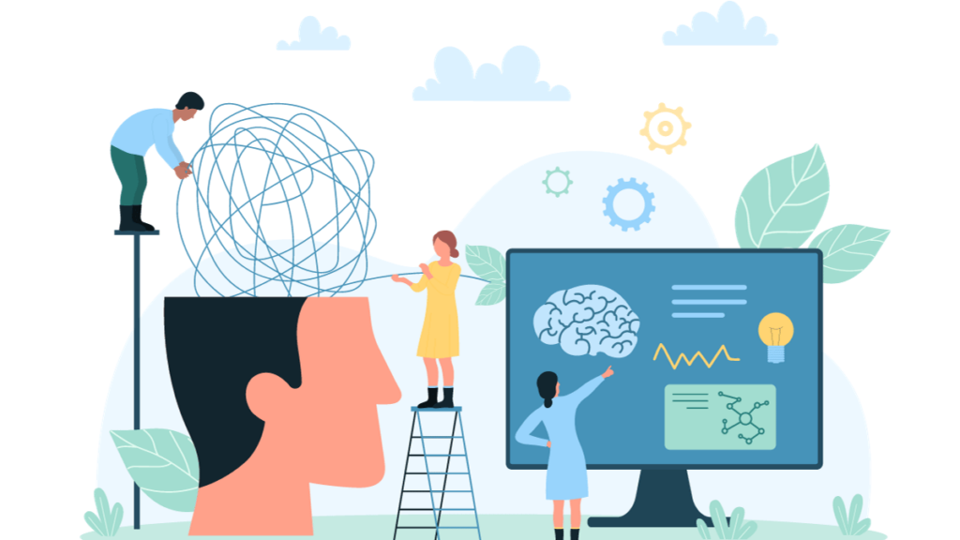

Personality Forecasting with ML and AI: Model Adaptation.
Prachi Varshney - 211288
Isha - 211293

Slide 2
Agenda
Introduction
Timeline
Applications
Areas of growth
Summary
Results
Primary goals
Future Works

Slide 3

Why we chose this area?
Data Insights: ML uncovers hidden patterns, driving breakthroughs in various fields.
Automation: ML automates tasks, freeing time for strategic work.
Decision Support: ML aids decision-making with data-driven predictions.
Continuous Learning: ML models adapt and improve with more data.
Versatility: ML applies across industries, offering wide-ranging solutions.
3

Slide 4
Why are we working on this Project?
Targeted Marketing & Recommendations
Personalized advertising
Product recommendations based on inferred personality traits
More effective marketing campaigns and a personalized user experience.
Improved Customer Service
Predicted personalities enable businesses to provide more appropriate customer service interactions
Such as connecting patient customers with less urgent support channels.
Candidate Screening
Personality prediction aids in identifying candidates who are a good cultural fit for a company and specific roles
Potentially leading to better hiring decisions and improved employee retention.
4

Slide 5
Continued…
Employee Development
Understanding employees' personalities helps managers assign tasks suited to their strengths and provide more effective coaching and development opportunities.
Other Uses
Personality prediction is also applied in dating apps to suggest compatible matches
In education to tailor teaching styles and identify areas needing additional support.
5

Slide 6
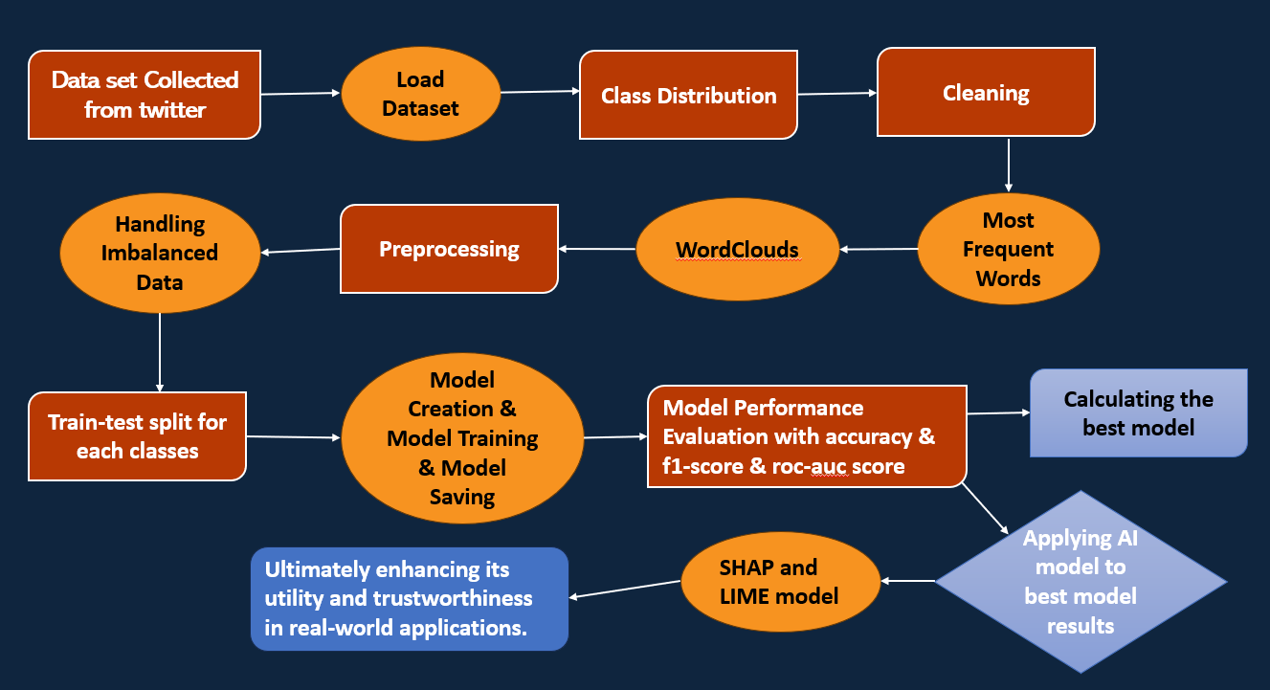

Slide 7
Why are we using Explainable AI Models ?
Machine learning models, especially complex ones like ensemble methods (e.g., RandomForest, XGBoost), are often considered "black boxes" because it's difficult to understand how they make their predictions. For practical applications, especially in fields where decisions based on these models have significant consequences (e.g., healthcare, finance), it's crucial to understand the rationale behind model predictions. This is where interpretability methods like LIME and SHAP come into play.

Slide 8
Lime and Shap
LIME:
Instance-Level Explanation: We used LIME to explain individual instances in our dataset. This helped in understanding the local behavior of our XGBoost model, providing insight into why specific predictions were made.
Transparency: By examining specific cases, LIME helps in ensuring that the model's decisions are transparent and justifiable.
SHAP:
Feature Importance: We used SHAP to get a comprehensive view of feature importance for our model. This helps in understanding which features are most influential across the dataset.
Visual Insights: SHAP’s visual tools (like summary plots, dependence plots, and force plots) make it easier to interpret how different features contribute to the model's predictions, both at the global and local levels.

Slide 9
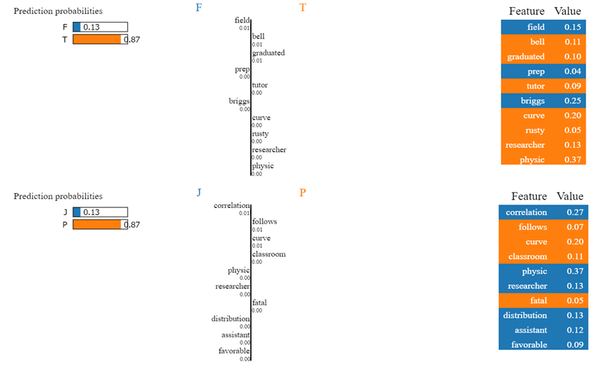
Graphical Outputs: LIME Results

Slide 10
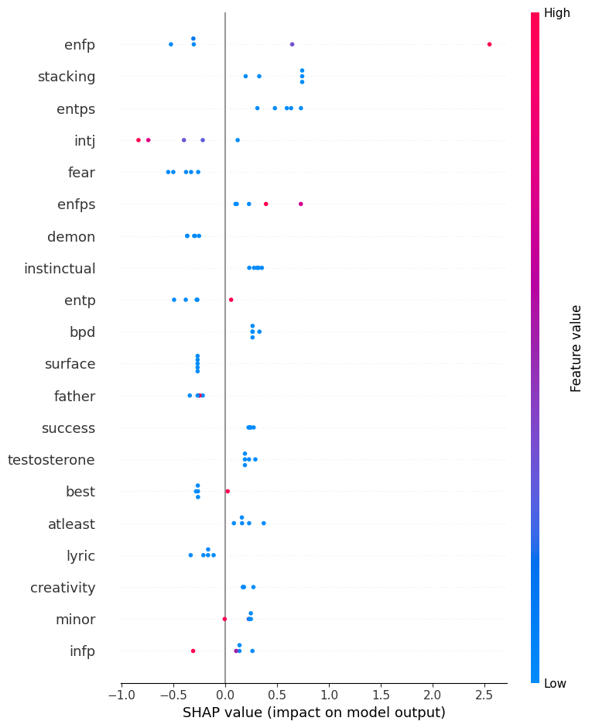
SHAP Results:

Slide 11
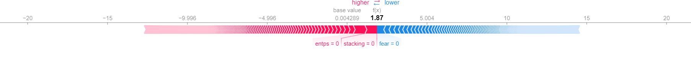
Force plot

Slide 12
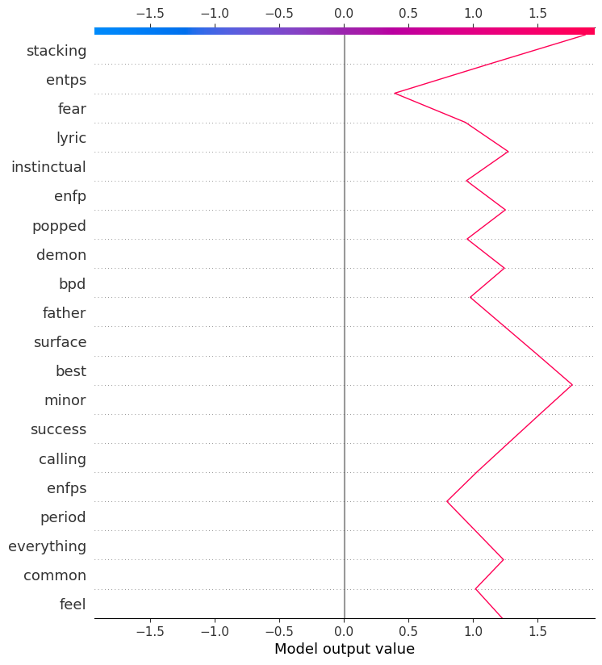
Dependency Plot :

Slide 13
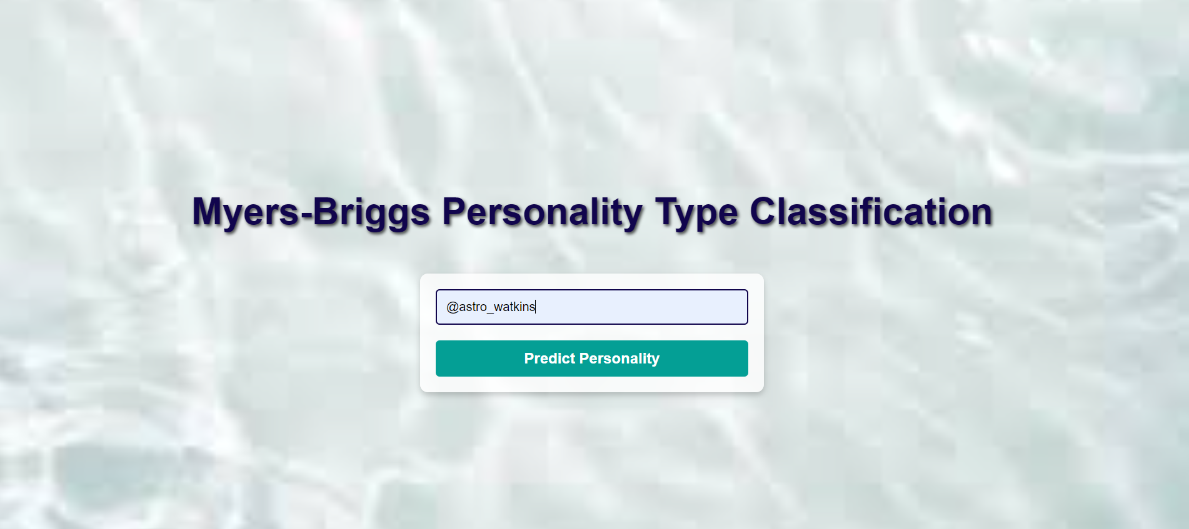
Interface Results:

Slide 14
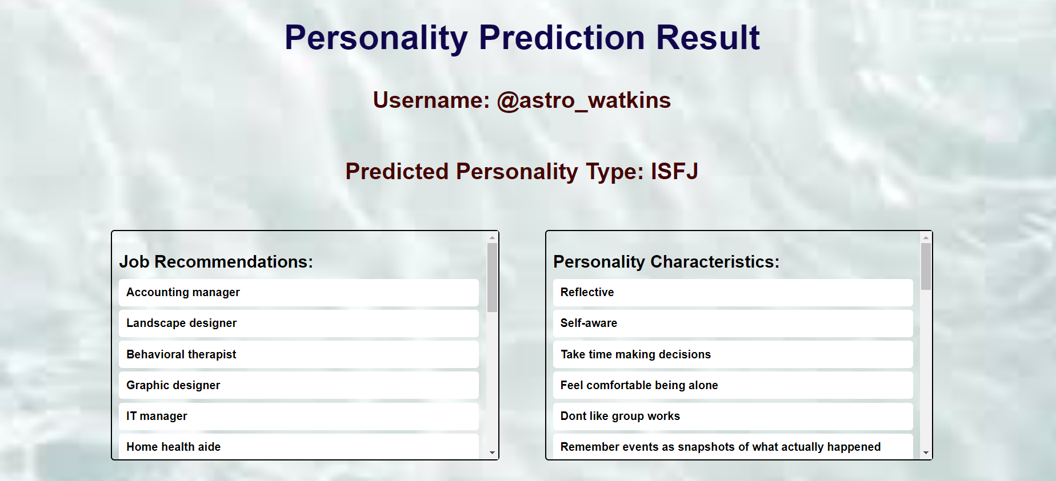

Slide 15
Applications:
Targeted Marketing and Advertising:
Personalized Campaigns: Understanding the personality traits of users can help marketers design personalized advertising campaigns that resonate more deeply with specific audiences.
Product Recommendations: Tailored product recommendations based on personality traits can increase conversion rates and customer satisfaction.
Customer Service Enhancement:
Tailored Communication: Customer service agents can adapt their communication styles based on the personality profiles of customers, leading to better customer experiences.
Chatbot Personalization: Chatbots can be designed to respond in ways that are more appealing to different personality types.
Human Resources and Recruitment:
Candidate Screening: Employers can use personality insights from social media to screen candidates, assessing traits that align with job requirements and company culture.
Team Composition: Understanding personality traits can help in forming balanced and cohesive teams.

Slide 16
Future Work:
Improving Data Quality and Diversity:
Broader Data Sources: Expand the dataset by incorporating data from multiple social media platforms (e.g., Facebook, Instagram, LinkedIn) to ensure a more comprehensive and representative dataset.
Enhanced Preprocessing: Develop advanced natural language processing (NLP) techniques to better handle noisy and unstructured text data, thereby improving the accuracy of personality predictions.
Addressing Privacy and Ethical Concerns:
Data Anonymization: Implement robust anonymization techniques to protect user identities and ensure compliance with data privacy regulations like GDPR[5].
Ethical Frameworks: Develop and adhere to stringent ethical guidelines for data collection, analysis, and the application of personality predictions to prevent misuse and ensure responsible AI usage.
Enhancing Model Accuracy and Generalizability:
Advanced ML Models: Experiment with state-of-the-art ML and NLP models (e.g., transformer-based models like BERT or GPT) to enhance the accuracy and reliability of personality predictions.
Cross-Platform Validation: Validate the model across various social media platforms and diverse demographic groups to ensure its robustness and generalizability.

Slide 17




Thank you

